Slide 1
Self Ticketing App
Rakha Naufal A.F – Mini Project Presentation

Slide 2
TABLE OF CONTENTS
01
04
02
05
03
ABOUT ME
APP FEATURES
Brief Introduction about myself
Features of the app
ABOUT THE APP
LIVE DEMO
5W + 1H about the app
Live demo app
TECH BEHIND THE APP
Technologies supporting the app

Slide 3
01
ABOUT ME

Slide 4



ABOUT ME
01
Rakha Naufal Akbar Fikri
Malang, Indonesia
: https://github.com/rnaufalaf
: https://www.linkedin.com/in/rnaufalaf/

Slide 5
02
ABOUT THE APP

Slide 6
About the App
03
02
01
WHY
WHO
Because finding information about holiday tickets could be tiresome ☹
WHAT
Me, with the continuous help from my mentor
An app to conduct sales of holiday tickets, all in one place

Slide 7
About the App
04
05
06
WHEN
WHERE
HOW
21 April 2022 – 27 April 2022
Malang, Indonesia
Will be explained in the next slide ☺

Slide 8
Tech Behind the App
F
B
Front - End
Back - End
HTML & CSS + Bootstrap CSS + EJS
JS & Node + PostgreSQL & Sequelize ORM

Slide 9
Why Using those Techs ?
HTML & CSS
Bootstrap CSS
EJS
CSS Framework for faster designing
Let you generate HTML with plain JS
Cornerstone of Web Development alongside JS
JS + Node
PostgreSQL
Sequelize ORM
Single-threaded, non-blocking, asynchronous
Offers more complex data types
Avoids query writing, less code

Slide 10
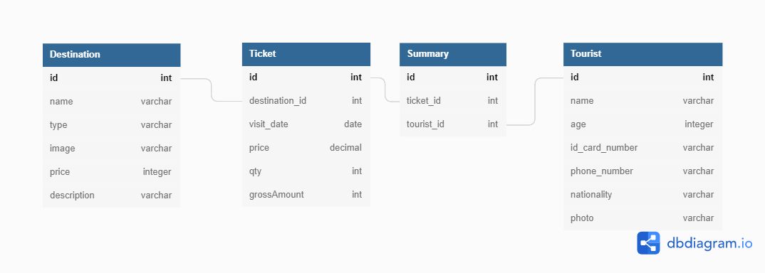
App Features - ERD

Slide 11
App Features – API Endpoints
No | HTTP Method | API Endpoints | Description
1 | Get | /destination | Get All Destinations
2 | Get | /destination/:id | Get Destination by ID
3 | Get | /destination/addDestination | Display Add Destination Form
4 | Post | /destination/add | Add Destination
5 | Get | /destination/delete/:id | Delete Destination by ID
6 | Get | /destination/updateDestination/:id | Display Update Destination Form
7 | Post | /destination/update/:id | Update Destination by ID

Slide 12
App Features – API Endpoints
No | HTTP Method | API Endpoints | Description
1 | Get | /tourist | Get All Tourists
2 | Get | /tourist/:id | Get Tourist by ID
3 | Get | /tourist/addTourist | Display Add Tourist Form
4 | Post | /tourist/add | Add Tourist
5 | Get | /tourist/delete/:id | Delete Tourist by ID
6 | Get | /tourist/updateForm/:id | Display Update Tourist Form
7 | Post | /tourist/update/:id | Update Tourist by ID
8 | Get | /tourist/assignTourist | Display Assign Tourist Page

Slide 13
App Features – API Endpoints
No | HTTP Method | API Endpoints | Description
1 | Get | /ticket | Get All Destination
2 | Get | /ticket/:id | Get Destination by ID
3 | Get | /ticket/addTicket/:TouristId | Display Add Destination Form
4 | Post | /ticket/add/:TouristId | Add Destination
5 | Get | /ticket/delete/:touristId/:id | Delete Destination by ID
6 | Get | /ticket/updateForm/touristId/:id | Display Update Destination Form
7 | Post | /ticket/update/:touristId/:id | Update Destination by ID

Slide 14
App Features – API Endpoints
No | HTTP Method | API Endpoints | Description
1 | Get | /summary | Get Summaries

Slide 15
Demo App

Slide 16
THANKS!
Please keep this slide for attribution

